Slide 1
H280 SCUD Vision Flow

Slide 2
H280 | Glue path AOI Vision flow change list
Station ID | Station Description | Vendor | Process Type |  | MIL
H280 |  | EW | Dispense

Slide 3
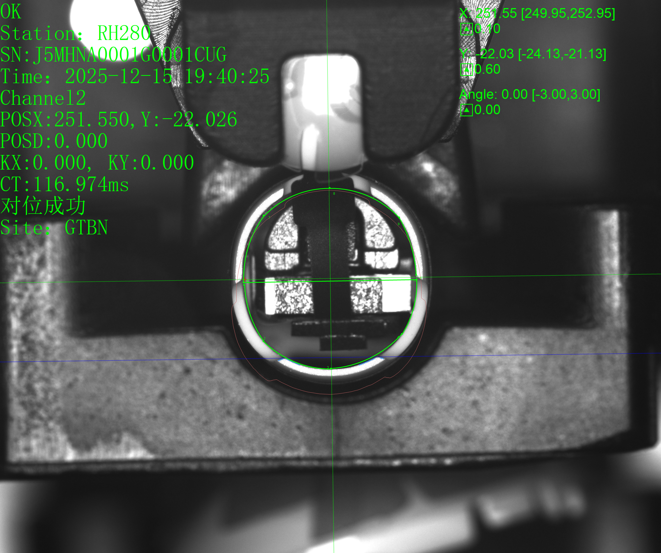
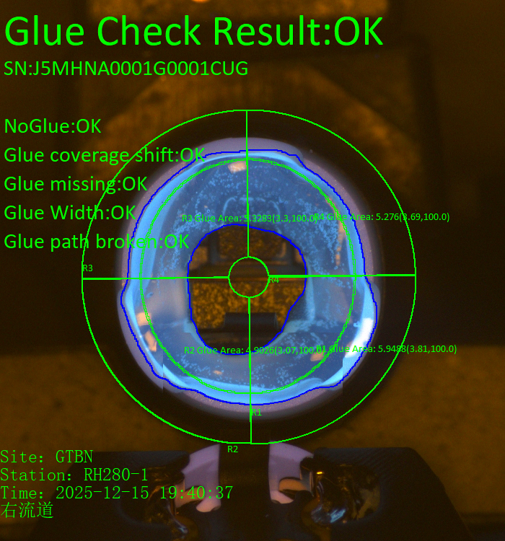


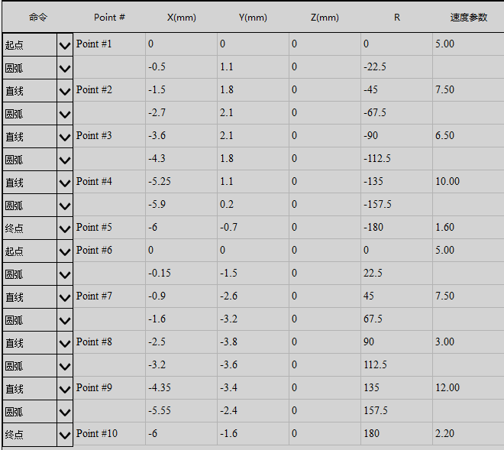
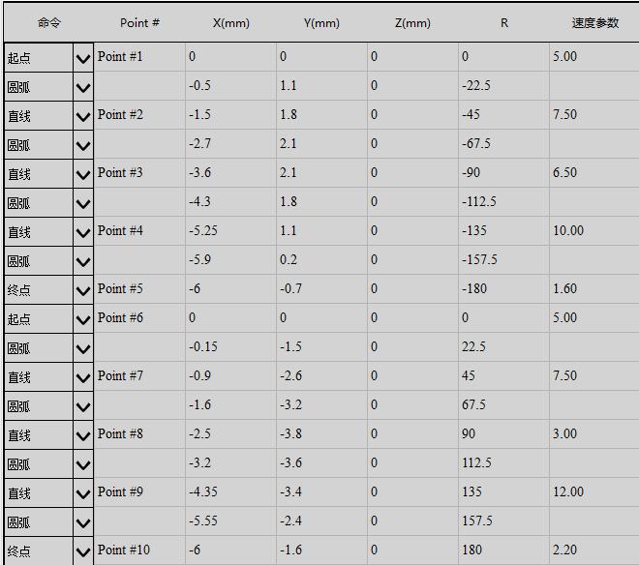
H280 | Glue path AOI introduction report
H280_Right gantry
H280_left gantry

Slide 4
Glue Dispense Vision Guidance
Thuật toán và quy trình xử lý để dẫn hướng máy thực hiện điểm keo.

Slide 5
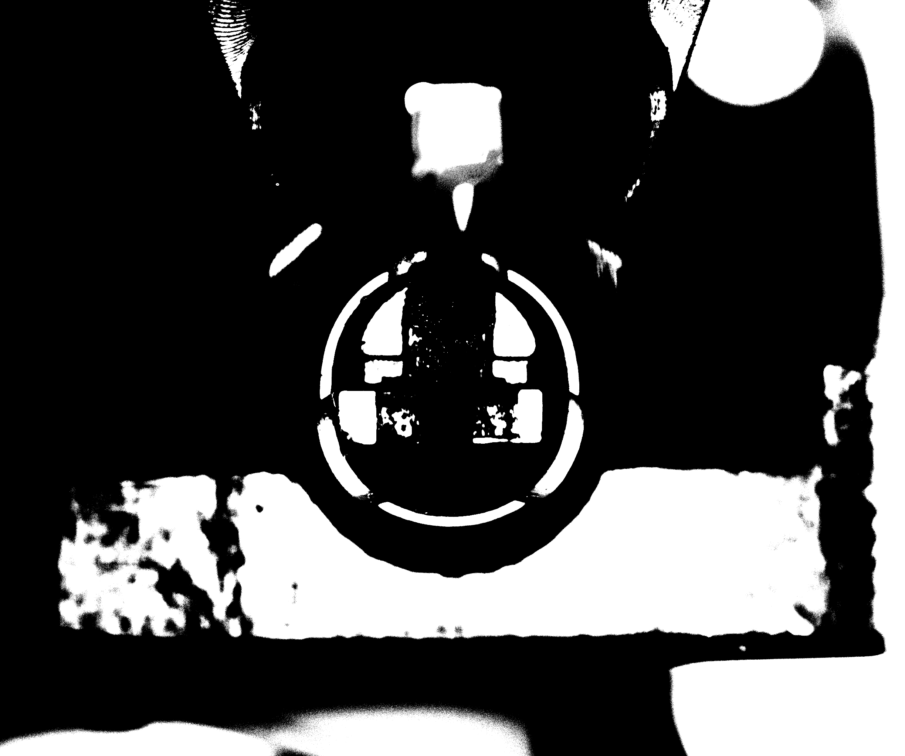
Audio | H280 Vision Flow | Image effect
Glue path
Golden image
Pixel dimension | 0.0086mm/pixel
Lens resolution | 2448*2048
FOV | 21*17.5mm
DOF | 5mm
Lightning Brightness | 255
Exposure time | 3

Slide 6
Audio | H280 Vision Flow | Glue path 1 – Workflow
START
Yes
CCD chụp ảnh
if No times <= 3
No
Bước 1: Hiệu chuẩn tương quan giữa Camera và hệ trục máy: sử dụng phương pháp hiệu chuẩn 9 điểm.
if |Fixed area image grayscale difference|< 15
No
Yes
Based on data collected by pp1
Bước 2: Tạo template; chọn điểm đặc trưng rõ ràng và ổn định.
Yes
Template matching (positioning product position)
if No times <= 3
No
Bước 3: Dạy quỹ đạo bơm keo
1. Sau khi tạo ảnh chuẩn làm mẫu thống nhất, các trạm sao chép khác có thể sử dụng mẫu này.;
2. Mỗi máy cần hiển thị độc lập quá trình căn chỉnh vật liệu và quỹ đạo điểm keo.;
3. Sử dụng mô hình ảnh chuẩn để xác định điểm trung tâm P theo mẫu. Dựa vào P để thiết lập vị trí vùng 1 và vùng 2, đồng thời thiết lập kích thước vùng nhằm huấn luyện giá trị mức xám trung bình của hai vùng này.
4. Khi huấn luyện vật liệu, lấy điểm giao M4 (x, y) của hai đặc trưng đường thẳng L và L4 làm điểm tâm tham chiếu (trang 10), và lấy đường thẳng L với góc D làm góc tham chiếu (trang 10).
If | Actual material specific region value-
Template material specific region value |<15
No
Based on data collected by pp1
Yes
Yes
Obtain the matching center point P '(X, Y), and place fixed size search boxes L’，L1’and L2’，L3’ based on the matching position
M1′ (X, Y) được tạo ra từ giao điểm của L′ và L1′; M2′ (X, Y) được tạo ra từ giao điểm của L2′ và L3′.M4′ (X, Y) được tạo bằng cách dịch chuyển điểm trung tâm M3′ của L4′ theo phương vuông góc với đường nối M1′ và M2′ một khoảng cố định; M4′ (X, Y) trừ đi điểm M4 (x, y) của vật liệu mẫu cho ra (x′, y′). Góc của đường thẳng L4′ là D; D trừ đi góc d1 của vật liệu mẫu cho ra d′.
Lưu ý: Quy trình này chỉ cần thực hiện một lần,nếu vị trí camera và trục thay đổi thì cần hiệu chuẩn lại;
Nếu thay đổi sản phẩm hoặc môi trường thiết bị làm tỷ lệ nhận dạng mẫu hoặc tìm đường thẳng thất bại cao thì cần tạo mẫu mới và thiết lập lại việc tìm đường thẳng;
Nếu độ lệch theo lô của van bơm keo là cố định thì cần dạy lại hoặc thêm giá trị bù cố định.
Pose proof :TX(2.616~3.347）mm
TY (2.2146~2.947）mm
No
if No times <= 3
Yes
No
Primary spec, pending further data collection
Send the absolute coordinates of (X, Y, D) to the machine and guide the dispensing process
send ng signal to alarm
finish Glue path AOI
Tossing NG

Slide 7
M03 | H280 | Vision Workflow
Pose 1 Vision Workflow
Step | Description | Page | Remark
1 | Creating coarse finder templates Pose1 | 8
2 | Pattern Matching in Pose1 | 9
3 | Finding lines | 10
4 | Foolproof | 21
6 | Glue path AOI Product Glue Path Edge | 25
7 | Glue path AOI Glue Area Region | 26

Slide 8
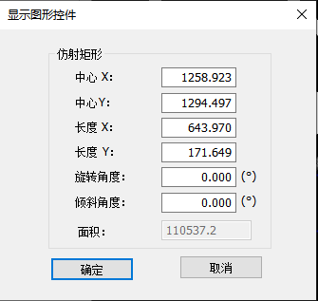
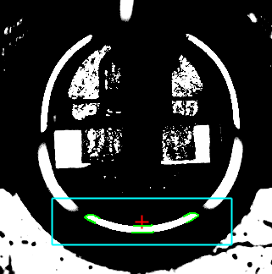
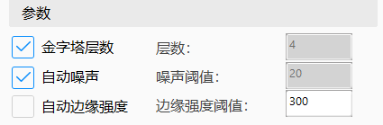
Audio | H280 Vision Flow | Glue path 1 - Create Template1
Select Golden image
Select clear and stable features and draw ‘contour feature area’ according to set fixed parameters
Set up the parameters for modeling (see training parameters attached)
Masking out other unstable and unwanted features in the ‘contour feature area’
Contour feature area
parameter
training parameters
Click on the template training to get the template
P1 contour centre
Modeling feature requirements：
1. Stable and clear outline edge, no dirty
2. Do not have multi-layer, complex contours
3. Search area, do not have a close shape of the edge of the contour
When modeling, make good use of the masking function to mask out the unwanted edge contour features. Leaving only stable and clear contour features
After the modeling is completed, need offline test with all the previous material images to confirm the compatibility of this template for all incoming materials.
Offset the fixed coordinates of the template center P to obtain the center of region 1
and region 2
Record the average gray values G1 and G2 respectively
Template 1
Use the center of the template as the reference center
Modeling Process

Slide 9
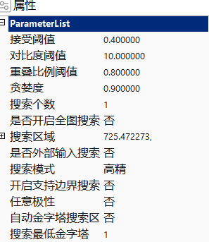
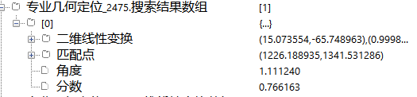
Audio | H280 Vision Flow | Glue path 1 - Pattern matching
Set matching parameter
After matching to the template, the P-point is calculated based on the template position, and then the size and position of this box is calculated based on the template angle and the size of the modeled contour feature area
Take image for incoming product
Search for the created template in the "Searching area"
Matching result
Compare all the contour features in the "search area" with the template for similarity, get all contours with scores greater than 0.5 , and sort all the scores from highest to lowest, then output the contour with the highest score
p’ centre of contour
contour region
Matching parameter
Point P’ is the center point of the matched contour feature and is sent to the machine as a guide point
Incoming material requirements:
1. to ensure that the difference between the material and the modeled material can not be too large (visual inspection can not have obvious differences in the structure)
2. region1 and region2 detection area, grayscale value and template material difference can not exceed ± 10
3. dirty, foreign matter also can not have a lot, can not obscure the modeled features;
Actual product
The algorithm outputs the similarity score of this contour, the location of the featured contour region (P’ coordinates), the angle, and a 2D linear transformation matrix
Matching process

Slide 10
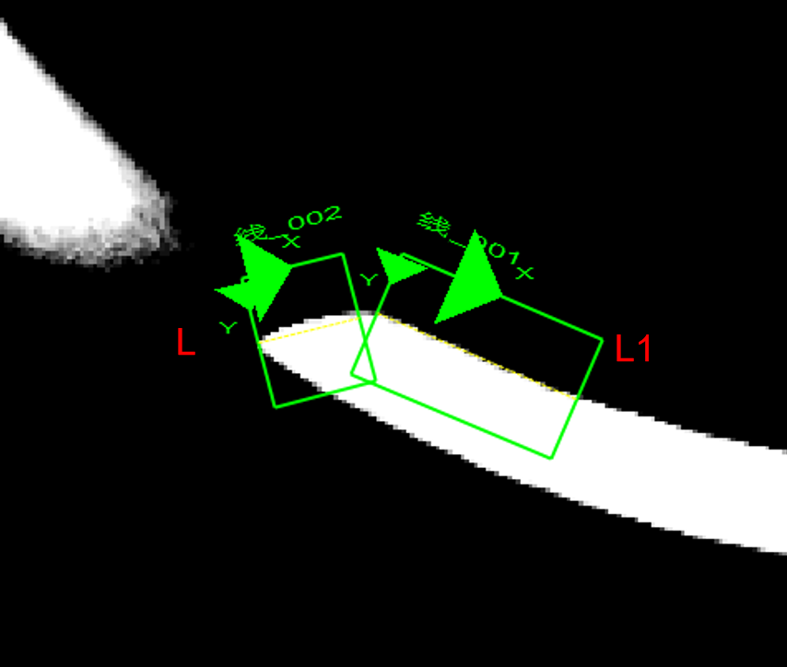
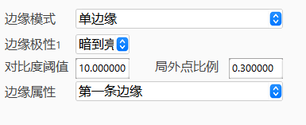
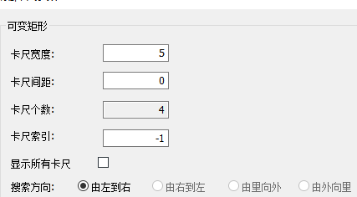
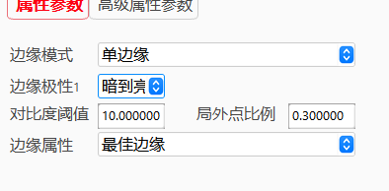
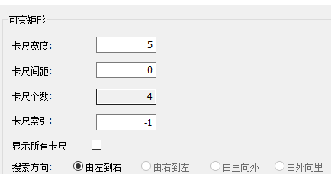
Audio | H280 Vision Flow | Glue path 1 – Finding lines
According to the template created, P-point offset (-320, -32) to get the center of the L line search box， offset (-263, -26) to get L1 line search box
L searching template
caliper parameter
According to the center of the line search box set the parameters, the line search box is automatically generated.
According to the caliper parameters, in the line search box, find the line L & L1
L1 searching template
caliper parameter
Line finding process
Search direction: left to right, dark to light
Feature selection:
Select a small section above the RVM that is relatively close to a straight line to represent the angle of the material, the length of the search box is 43pixel and the height is 34pixel

Slide 11
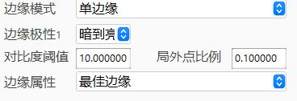
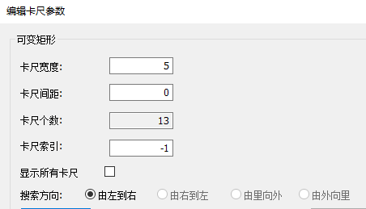
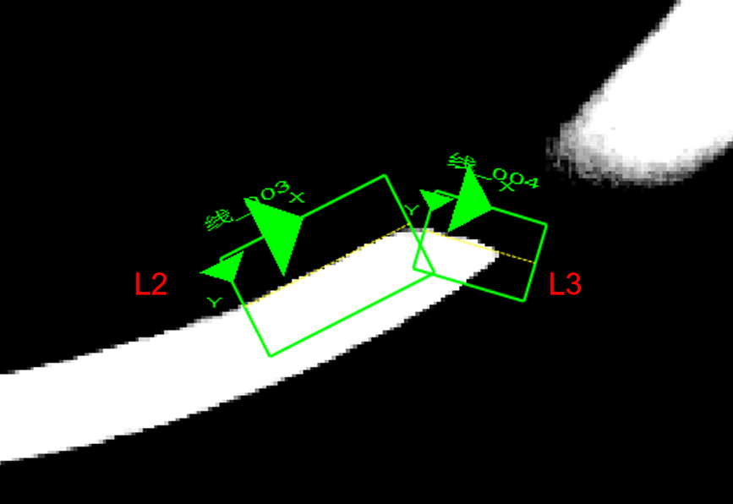
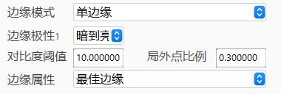
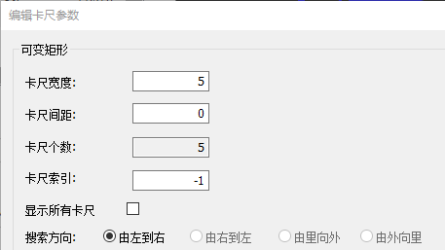
Audio | H280 Vision Flow | Glue path 1 – Finding lines
According to the template created in Page10, P-point offset (314, -35) to get the center of the L2 line search box ， offset (260, -34) to get the center of the L3 line search box
L2 searching template
L2 caliper parameter
According to the center of the line search box set the parameters, the line search box is automatically generated.
According to the caliper parameters, in the line search box, find the line L2 & L3
L3 searching template
L3 caliper parameter
Line finding process
Search direction: left to right, dark to light
Feature selection:
Select a small section above the RVM that is relatively close to a straight line to represent the angle of the material, the length of the search box is 43pixel and the height is 34pixel

Slide 12
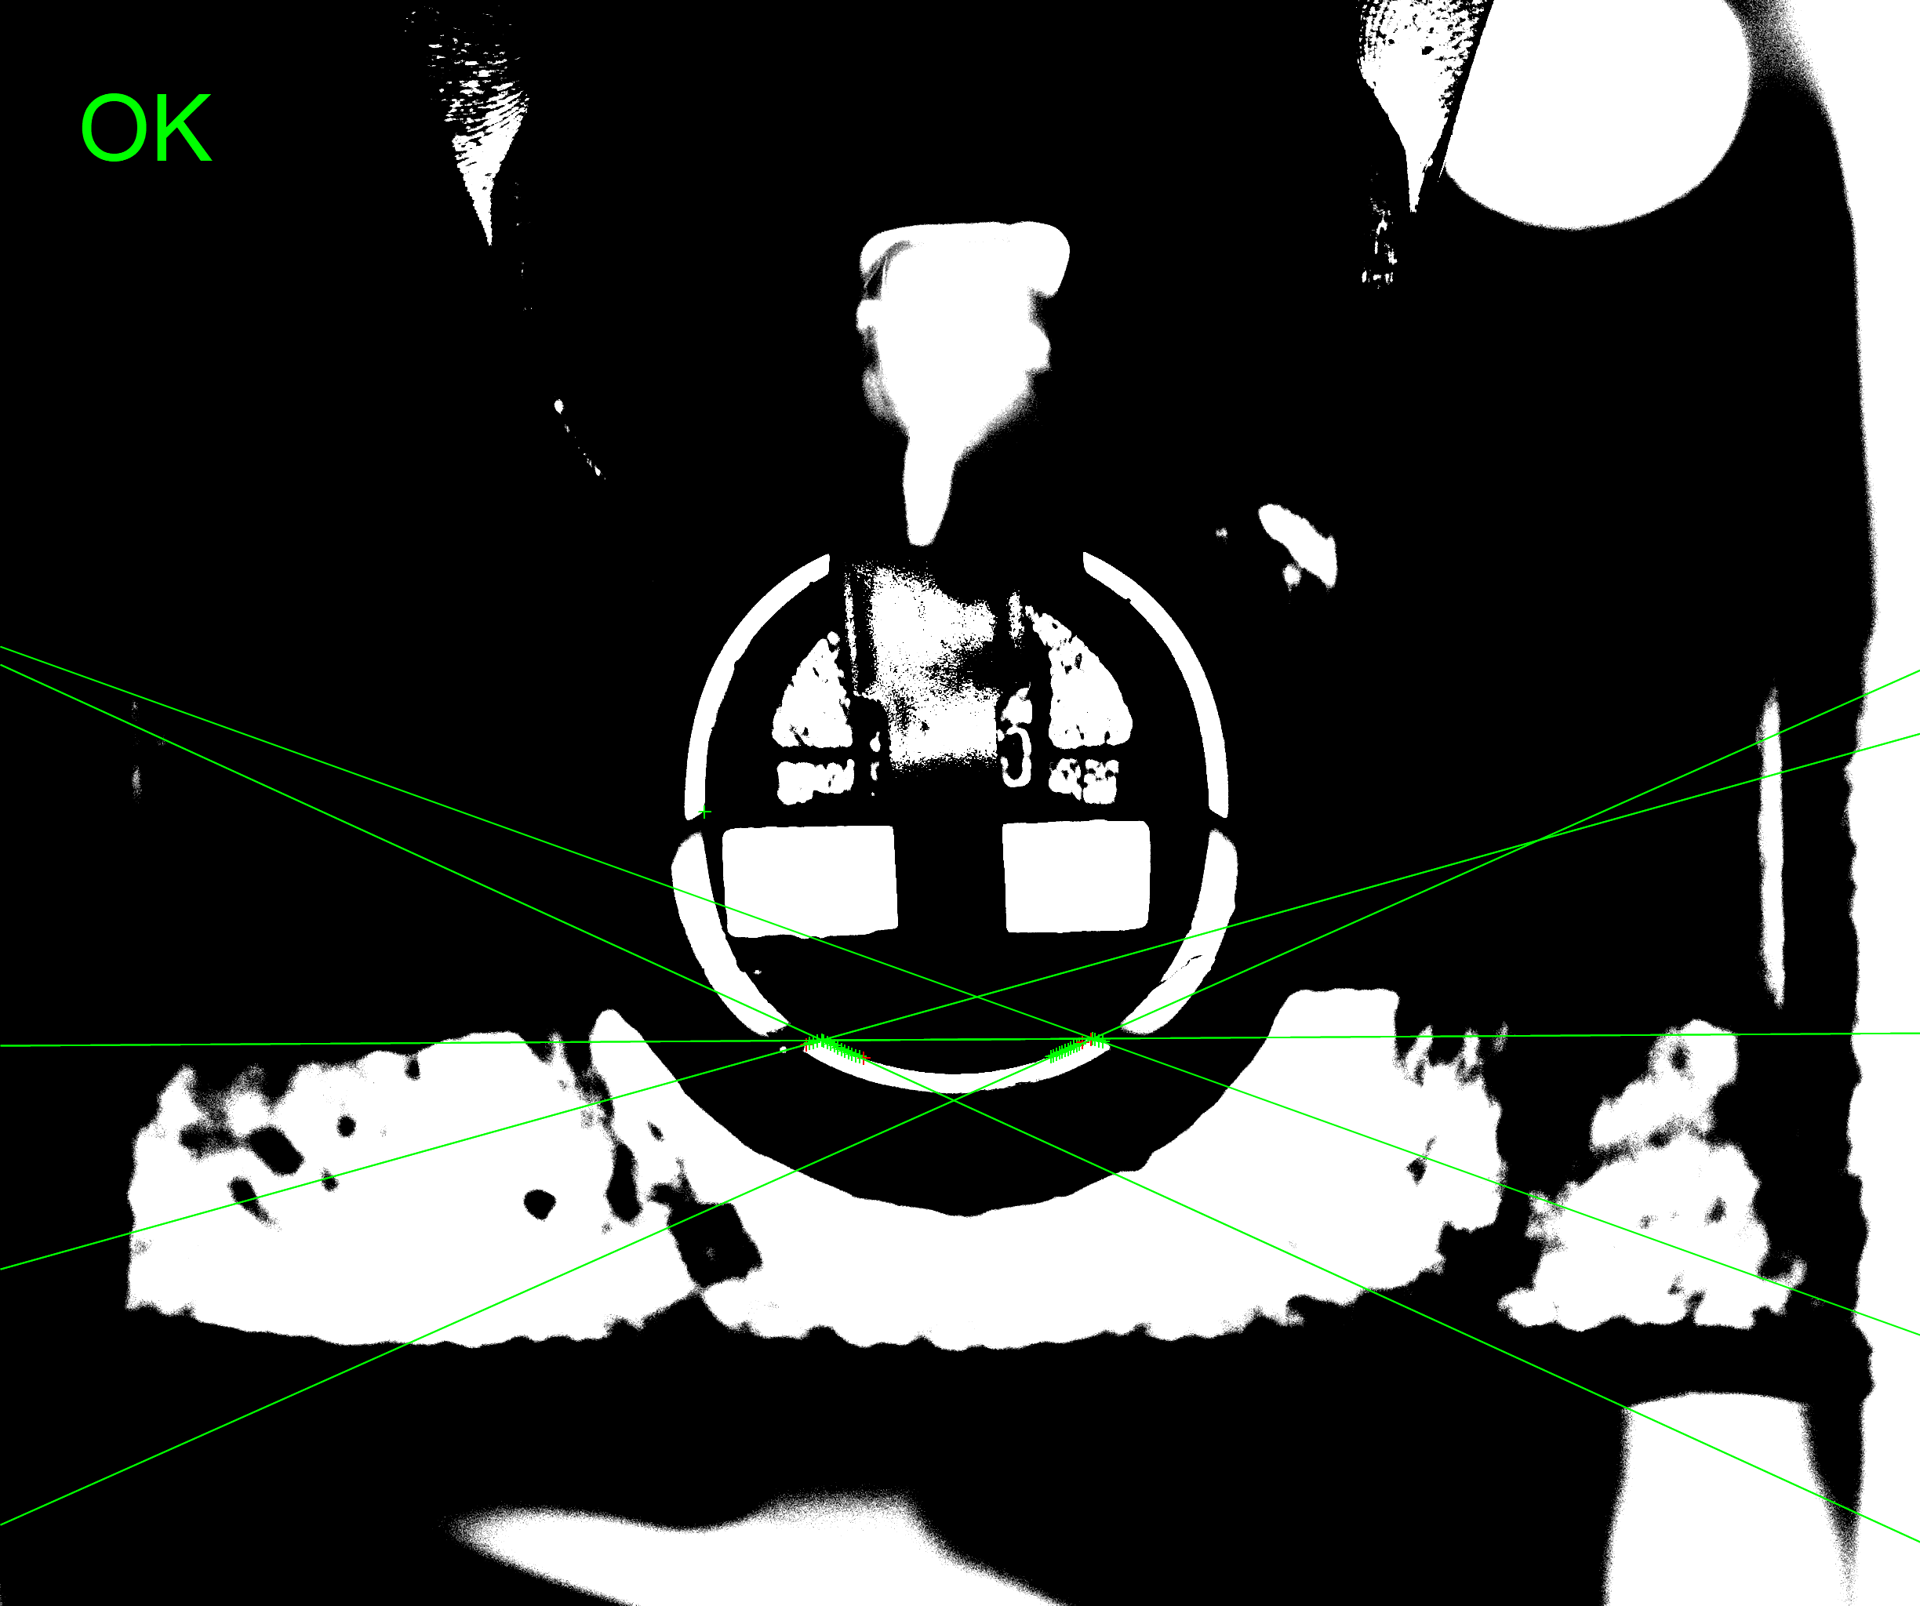
Audio | H280 Vision Flow | Glue path 1 – Finding lines
Get template
Get template matching result
Demonstrate the relationship between the results of "template matching" and the search box of the search line
L1
L4
M1
M2
Generate M1 as the intersection of L & L1，generate M2 as intersection of L2 & L3， generate line L4 as connection of M1 and M2
L
L2
L3
Set the angle of the L4 as the reference angle
Angle demonstration process
Template angle
The angle of the line L4 generate from the connection of M1 and M2 is used as the reference angle of the template material.

Slide 13
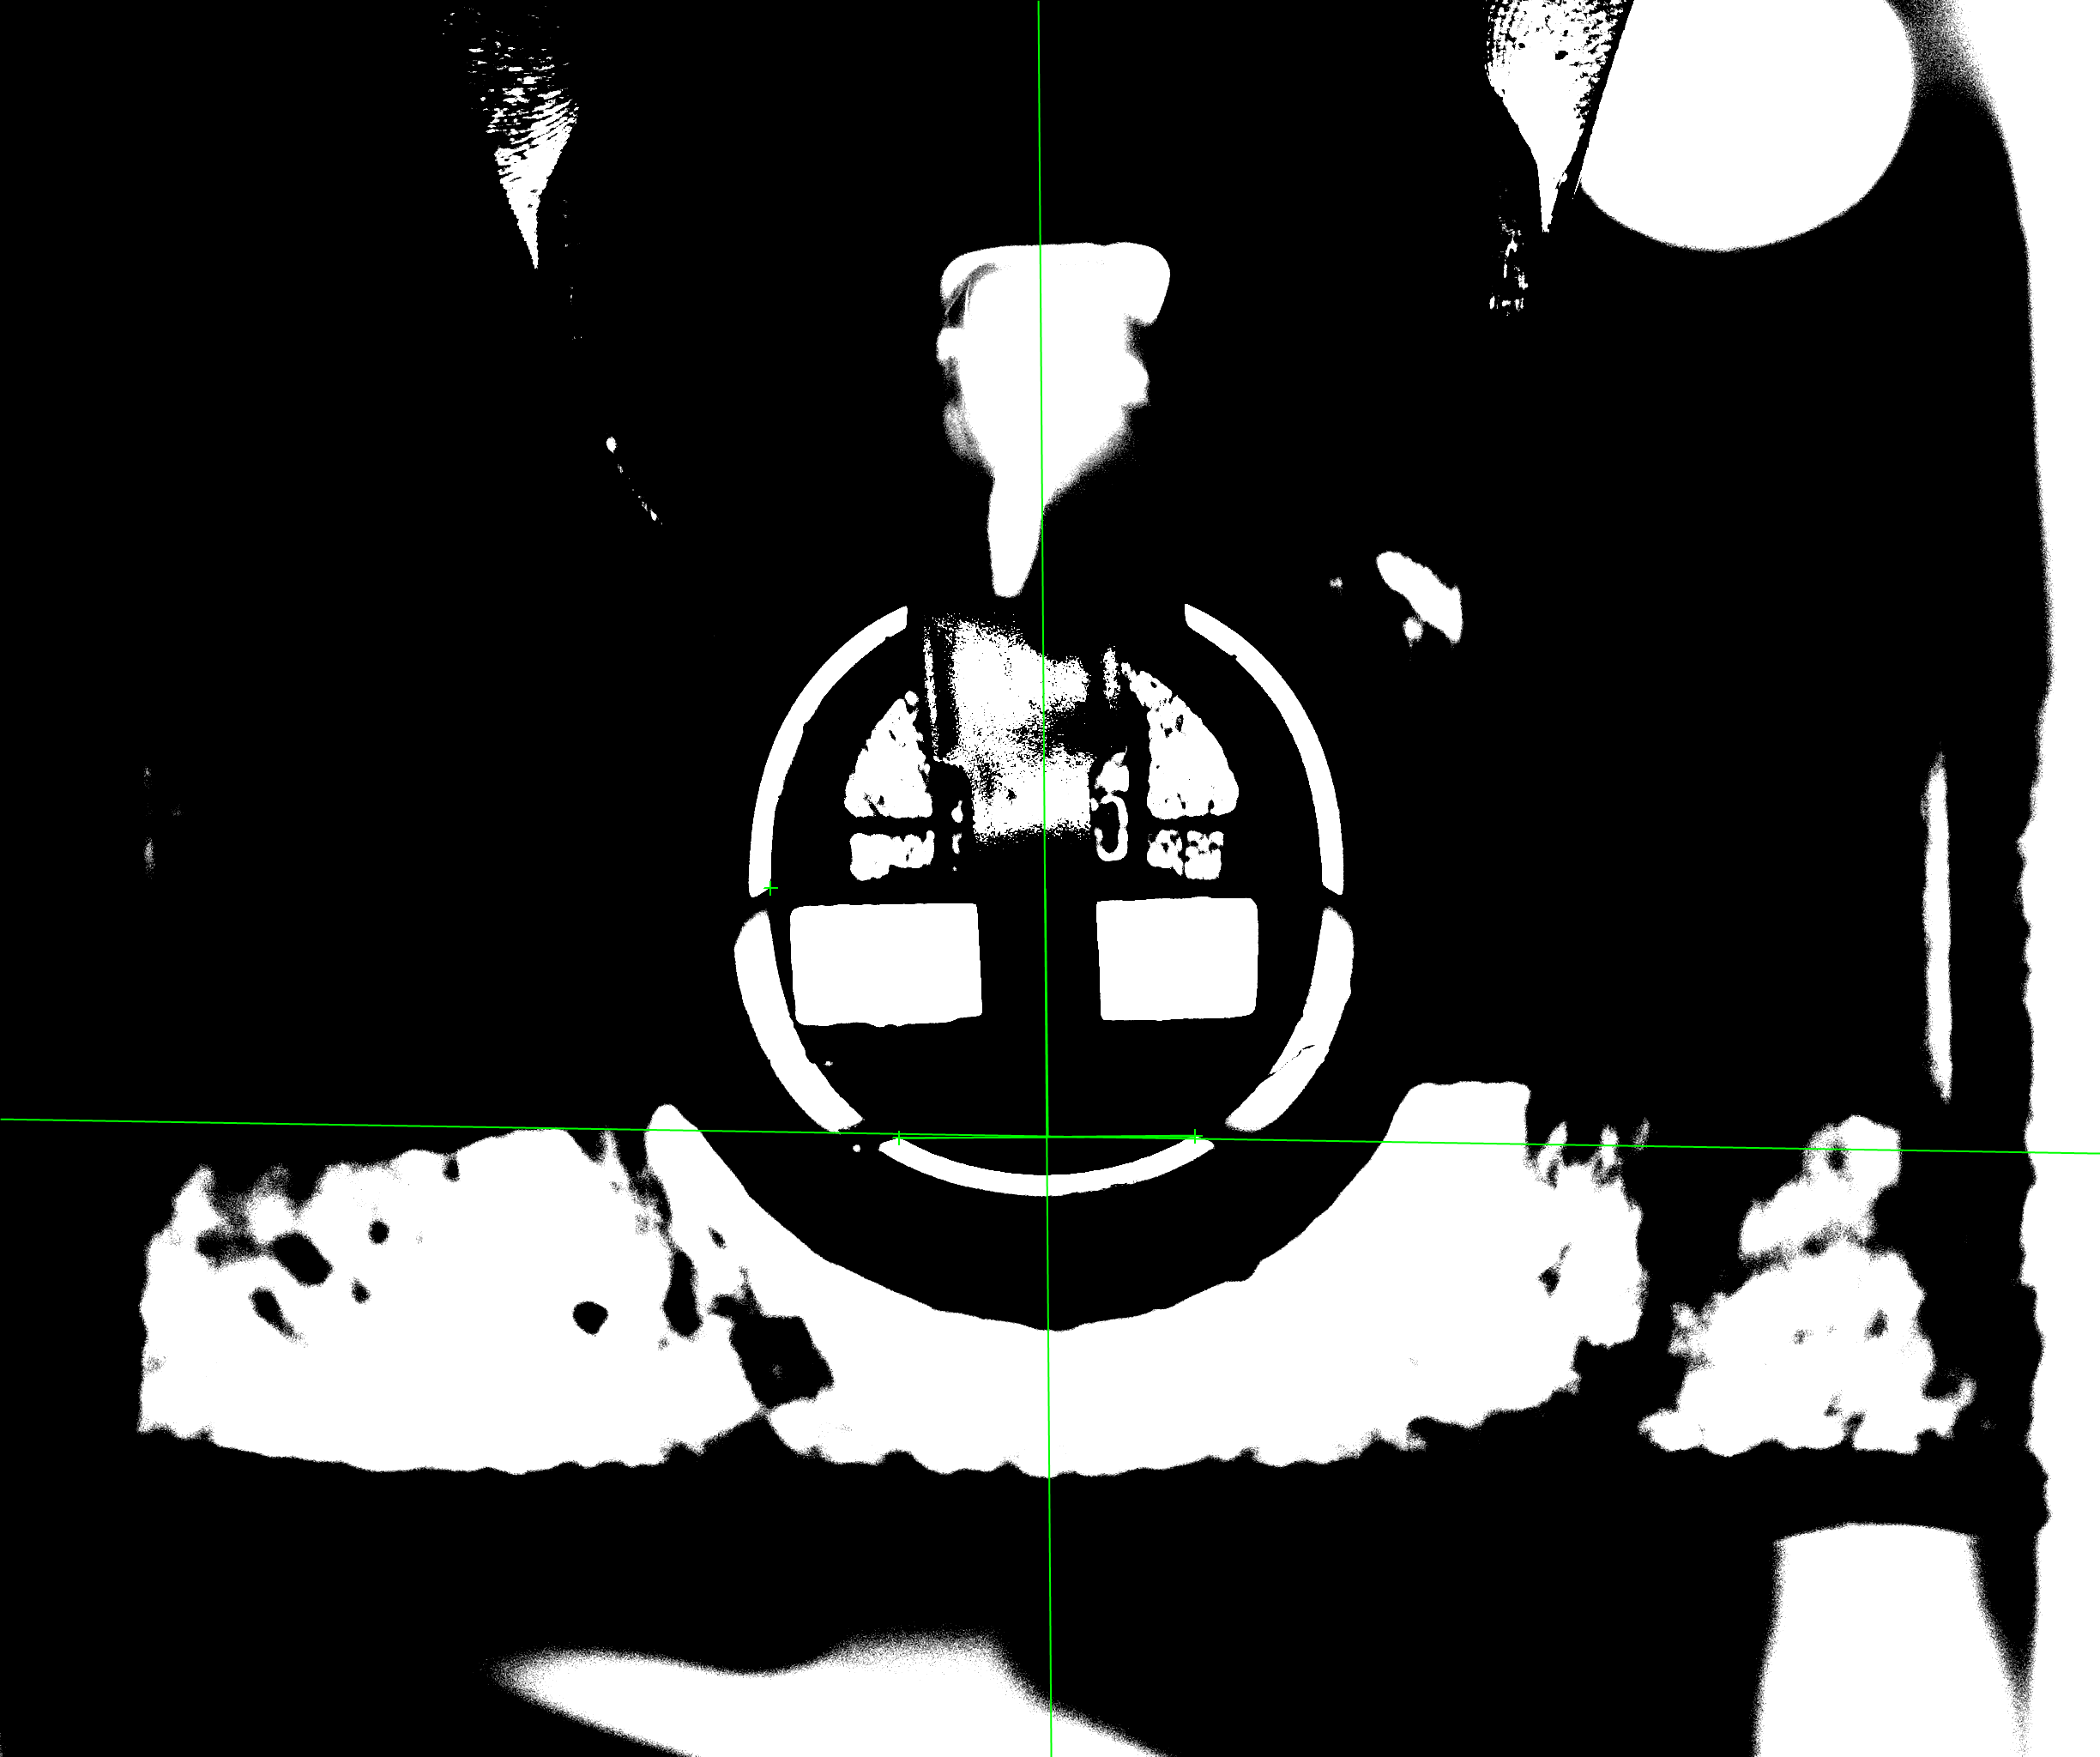
Audio | H280 Vision Flow | Glue path 1 – Create standard point
Generate M3 as middle point
of M1 and M2
L5
Do the vertical line of L4 through point M3 to generate L5
M4
M1
M2
L4
Offset M3 by a distance of -2.75 in the direction of L4 and -2.55 in the direction of L5 to generate M4 (X, Y)
M3
Send M4(X,Y) as reference point to dispenser
Send M4（X,Y） as reference point to dispenser
Demonstrate reference point

Slide 14
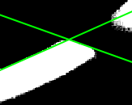
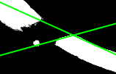
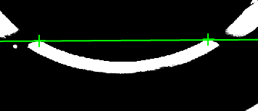
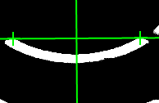
Audio | H280 Vision Flow | Glue path 1 – Create standard point
Generate M1' points from L' and L1'
M2’
M1’
L1’
Generate M2' points from L2' and L3'
L’
L2’
L3’
generate line L4’ as connection of M1’ and M2’
Generate M1’
Generate M2’
generate point M3’ as connection of M1’ and M2’
M1’
M2’
L4’
Generate L4’
The vertical line of L4' through point M3' is L5'.
L5’
Reference point generation process
L4’
M3’
Generate M3’ and L5’
M1’
M2’

Slide 15
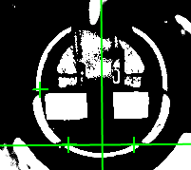
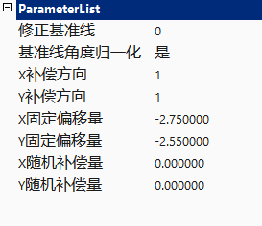
Audio | H280 Vision Flow | Glue path 1 – Create standard point
Offset M3 by a distance of -2.75mm in the direction of L4 and -2.55mm in the direction of L5 to generate M4 (X, Y)
Send M4’（X，Y）and L4’angle D1’ to dispenser
L5’
M4’
M1’
M2’
L4’
M3’
Send M4’as reference point and L4’ as reference angle to dispenser
Reference point generation process
M4’ parameter

Slide 16
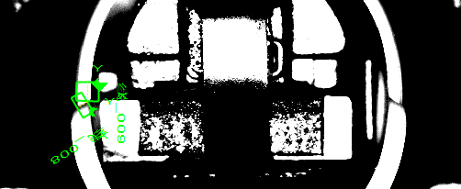
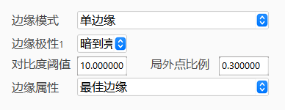
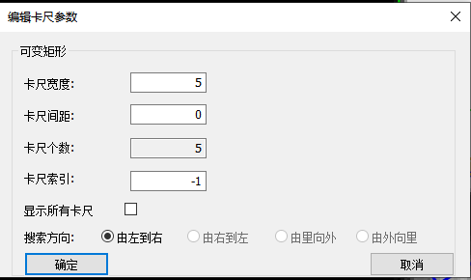
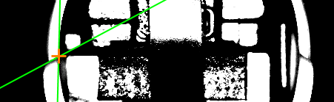
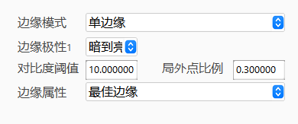
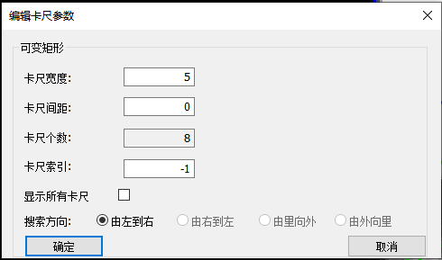
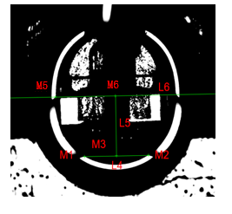
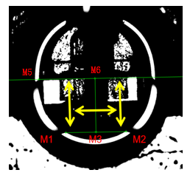
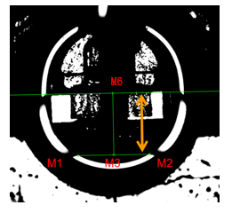
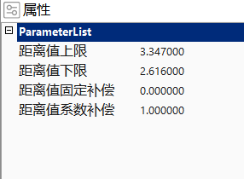
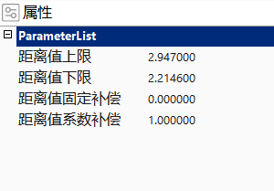
Audio | H280 Vision Flow | Glue path 1 - fool proof
Generate M5 points from L7 and L8
L8
L7
Move L4, upward so that it intersects point M5; the resulting line is L6
L7 caliper parameter
L7caliper parameter
L8
L7
Get TX &TY, its the material assemble position
L8 caliper parameter
L8caliper parameter
The spec of TX&TY, TX: (2.616~3.347）mm, TY: (2.2146~2.947）mm
Generate foolproof distance
TX: (2.616~3.347）mm
TY: (2.2146~2.947）mm

Slide 17
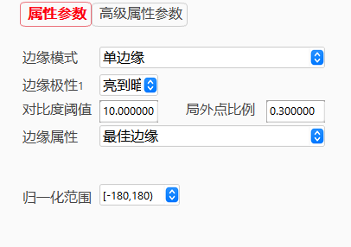
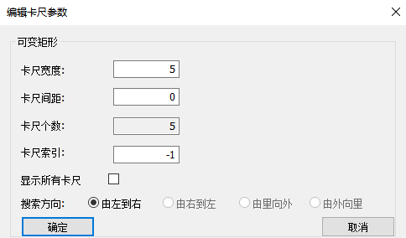
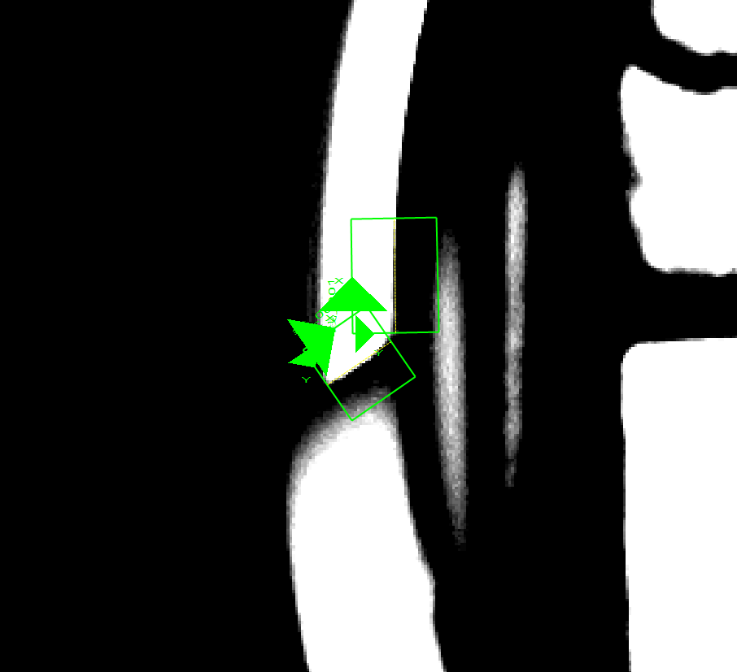
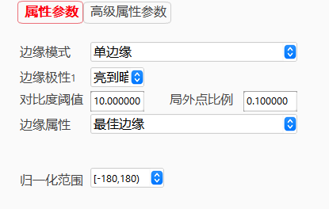

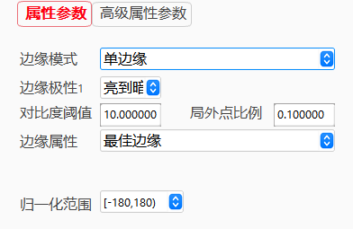
Audio | H280 Vision Flow | Glue path 1 – Second capture line Finding lines
According to the template created, P-point offset (-320, -32) to get the center of the L line search box， offset (-263, -26) to get L1 line search box
L1
According to the center of the line search box set the parameters, the line search box is automatically generated.
L
L searching template
caliper parameter
According to the caliper parameters, in the line search box, find the line L & L1
L1 searching template
caliper parameter
Line finding process
Search direction: left to right, dark to light
Feature selection:
Select a small section above the RVM that is relatively close to a straight line to represent the angle of the material, the length of the search box is 43pixel and the height is 34pixel

Slide 18
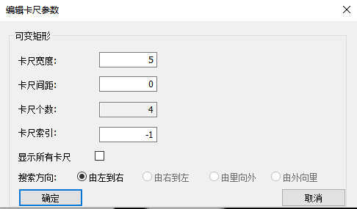
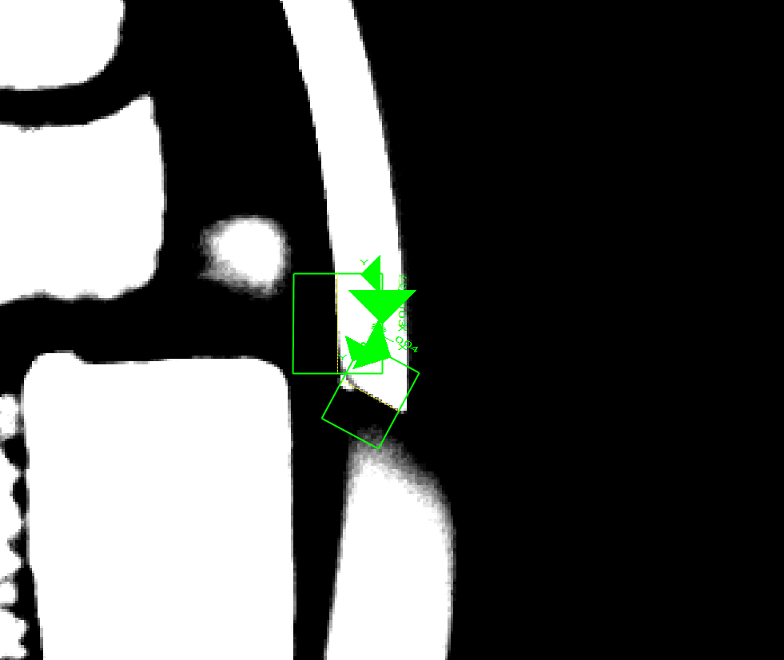
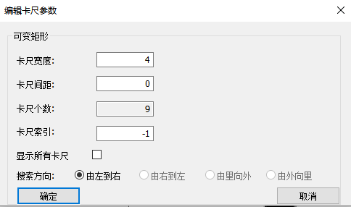
Audio | H280 Vision Flow | Glue path 1 – Second capture line Finding lines
According to the template created in Page10, P-point offset (314, -35) to get the center of the L2 line search box ， offset (260, -34) to get the center of the L3 line search box
L3
L2 searching template
L2 caliper parameter
According to the center of the line search box set the parameters, the line search box is automatically generated.
L2
According to the caliper parameters, in the line search box, find the line L2 & L3
L3 searching template
L3 caliper parameter
Line finding process
Search direction: left to right, dark to light
Feature selection:
Select a small section above the RVM that is relatively close to a straight line to represent the angle of the material, the length of the search box is 43pixel and the height is 34pixel

Slide 19
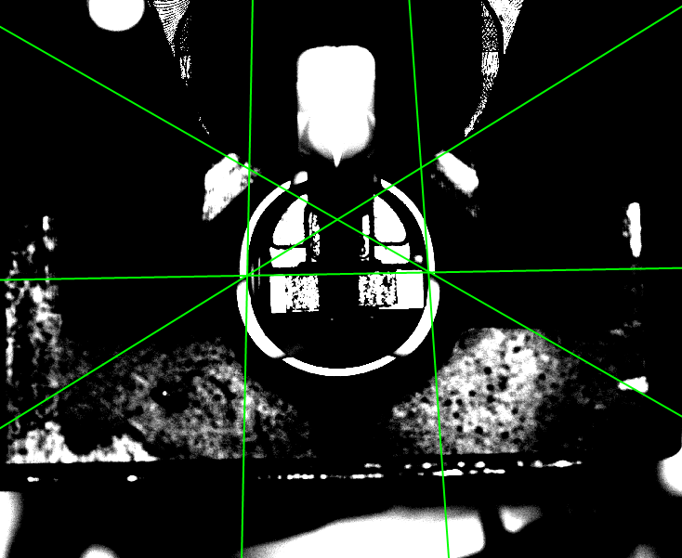
Audio | H280 Vision Flow | Glue path 1 – Second capture line Finding lines
Get template
Get template matching result
Demonstrate the relationship between the results of "template matching" and the search box of the search line
L1
L3
M1
M2
L4
L
L2
Generate M1 as the intersection of L & L1，generate M2 as intersection of L2 & L3， generate line L4 as connection of M1 and M2
Set the angle of the L4 as the reference angle
Angle demonstration process
Template angle
The angle of the line L4 generate from the connection of M1 and M2 is used as the reference angle of the template material.

Slide 20
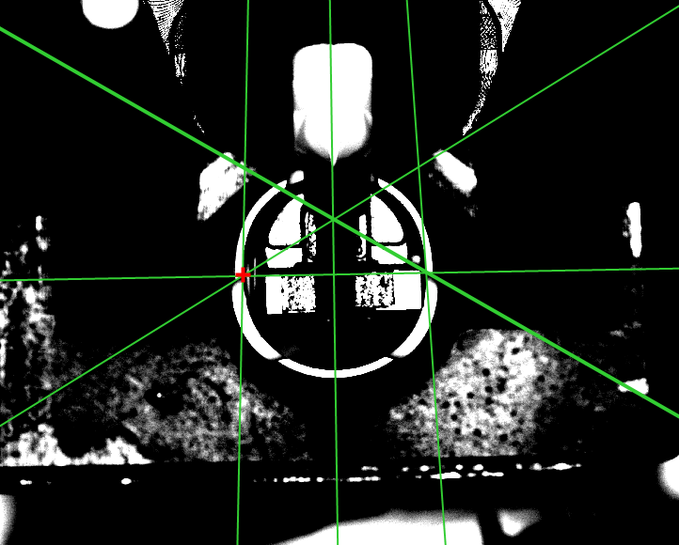
Audio | H280 Vision Flow | Glue path 1 – Second capture line Create standard point
Generate M3 as middle point
of M1 and M2
Do the vertical line of L4 through point M3 to generate L5
M3
L4
M4
L5
Offset M3 by a distance of -2.765 in the direction of L4 and -0 in the direction of L5 to generate M4 (X, Y)
Send M4(X,Y) as reference point to dispenser
Send M4（X,Y） as reference point to dispenser
Demonstrate reference point

Slide 21
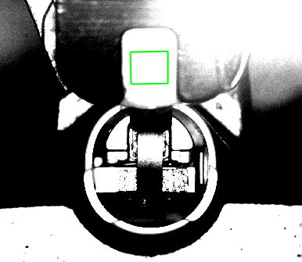




Audio | H280 Vision Flow | Glue path 1– Gray value fool-proof
During guided positioning, use the grayscale detection tool to place an affine rectangular ROI box on the plug.
Region1
Region1 parameter
caliper parameter
The average gray level of the plug within the detection area.
Grayscale range: 0–255
If the average gray value is “< 90”, it is judged that the plug has detached and the batch is rejected (NG).
Gray value fool-proof

Slide 22






Audio | H280 Vision Flow | Glue path 2– Gray value fool-proof
After the first adhesive layer is applied, the system flips the plug and the wiring harness. Using a grayscale detection tool, an ROI rectangle is placed at the corresponding location in the flipped image for inspection.
Region1
Measure how the average gray value at the flipped location changes.
Region1 parameter
caliper parameter
Grayscale detection range: 0–255
If the average gray value is < 225, it is judged “OK”.
Gray value fool-proof

Slide 23
Glue Path AOI MSOP
The algorithm, inspection definition and spec of the glue path AOI.

Slide 24
H280 | Glue path AOI Product Glue Path Edge
No Glue
Pre-dispense image
Post-dispense image
The areas of the glue ＞0mm²
Glue Coverage-Shift
R3
R4
The R1 coverage line should be >=100 % covered by glue path
R2
R1
R1
Glue Missing
Legend：
Glue Path Edge
Glue Coverage Line
Glue Area Region
Keep out zone
Glue Broken
The gap of glue breakage ≤ 0.1 mm
Pix accuracy:0.0086mm/pix
Region | No Glue | Glue Coverage-Shift | Glue Missing-Area | Glue Broken
R1 | Glue area＞0mm² | ≥100% | Glue area＞3.81mm² | ≤0.1mm
R2 | Glue area＞0mm² | ≥100% | Glue area＞3.07mm² | ≤0.1mm
R3 | Glue area＞0mm² | ≥100% | Glue area＞3.3mm² | ≤0.1mm
R4 | Glue area＞0mm² | ≥100% | Glue area＞3.69mm² | ≤0.1mm

Slide 25



Audio | Glue path AOI Product Glue Path Edge
Step 1#
Step 2#
Step 3#
Source image (post-dispense)
extract glue color
extract result
missing
Step 2#
The purpose of this process is used to extract the Glue path
Step 1# Capture pose1 source image
Step 2# Extract the color of glue path
Step 3# Inspect the glue path

Slide 26






Audio | Glue path AOI Glue Area Region
RGB to gray
pattern match
find line/circle
Step 1#
Step 2#
Step 3#
Step 4#
Create
coordinate system
R3
R4
R2
R1
Step 6#
Step 5#
The purpose of this process is used to find the position for dispense and region for coverage inspection:
Step 1# Capture pos1 source image
Step 2# RGB image to gray image
Step 3# Pattern match to get the place of the product
Step 4# Grab the product characteristics of circle to obtain C1, point P is center point of curve.
Step 5# Establish a product coordinate system by using P0.
Step 6# Place the glue inspection region according to product coordinate system

Slide 27



H280 | Glue path AOI Product glue Inspection logic
Pose1_Missing_R1 MIN: 5.4375 Pose1_Missing_R1 MAX: 6.5141 Pose1_Missing_R1 Data
R1 Missing spec= Pose1_Missing_R1 MIN*0.7=5.4375*0.7=3.81

Slide 28



H280 | Glue path AOI Product glue Inspection logic
Pose1_Missing_R2 MIN: 4.3821 Pose1_Missing_R2 MAX: 5.8742 Pose1_Missing_R2 Data
R1 Missing spec= Pose1_Missing_R1 MIN*0.7=4.3821*0.7=3.07

Slide 29



H280 | Glue path AOI Product glue Inspection logic
Pose1_Missing_R3 MIN: 4.7168 Pose1_Missing_R3 MAX: 6.4701 Pose1_Missing_R3 Data
R1 Missing spec= Pose1_Missing_R1 MIN*0.7=4.7168*0.7=3.3

Slide 30



H280 | Glue path AOI Product glue Inspection logic
Pose1_Missing_R4 MIN: 5.276 Pose1_Missing_R4 MAX: 6.2779 Pose1_Missing_R4 Data
R1 Missing spec= Pose1_Missing_R1 MIN*0.7=5.276*0.7=3.69

